Slide 1

Algorithms & Data Structures
Week 5
Heaps & Hash tables

Slide 2
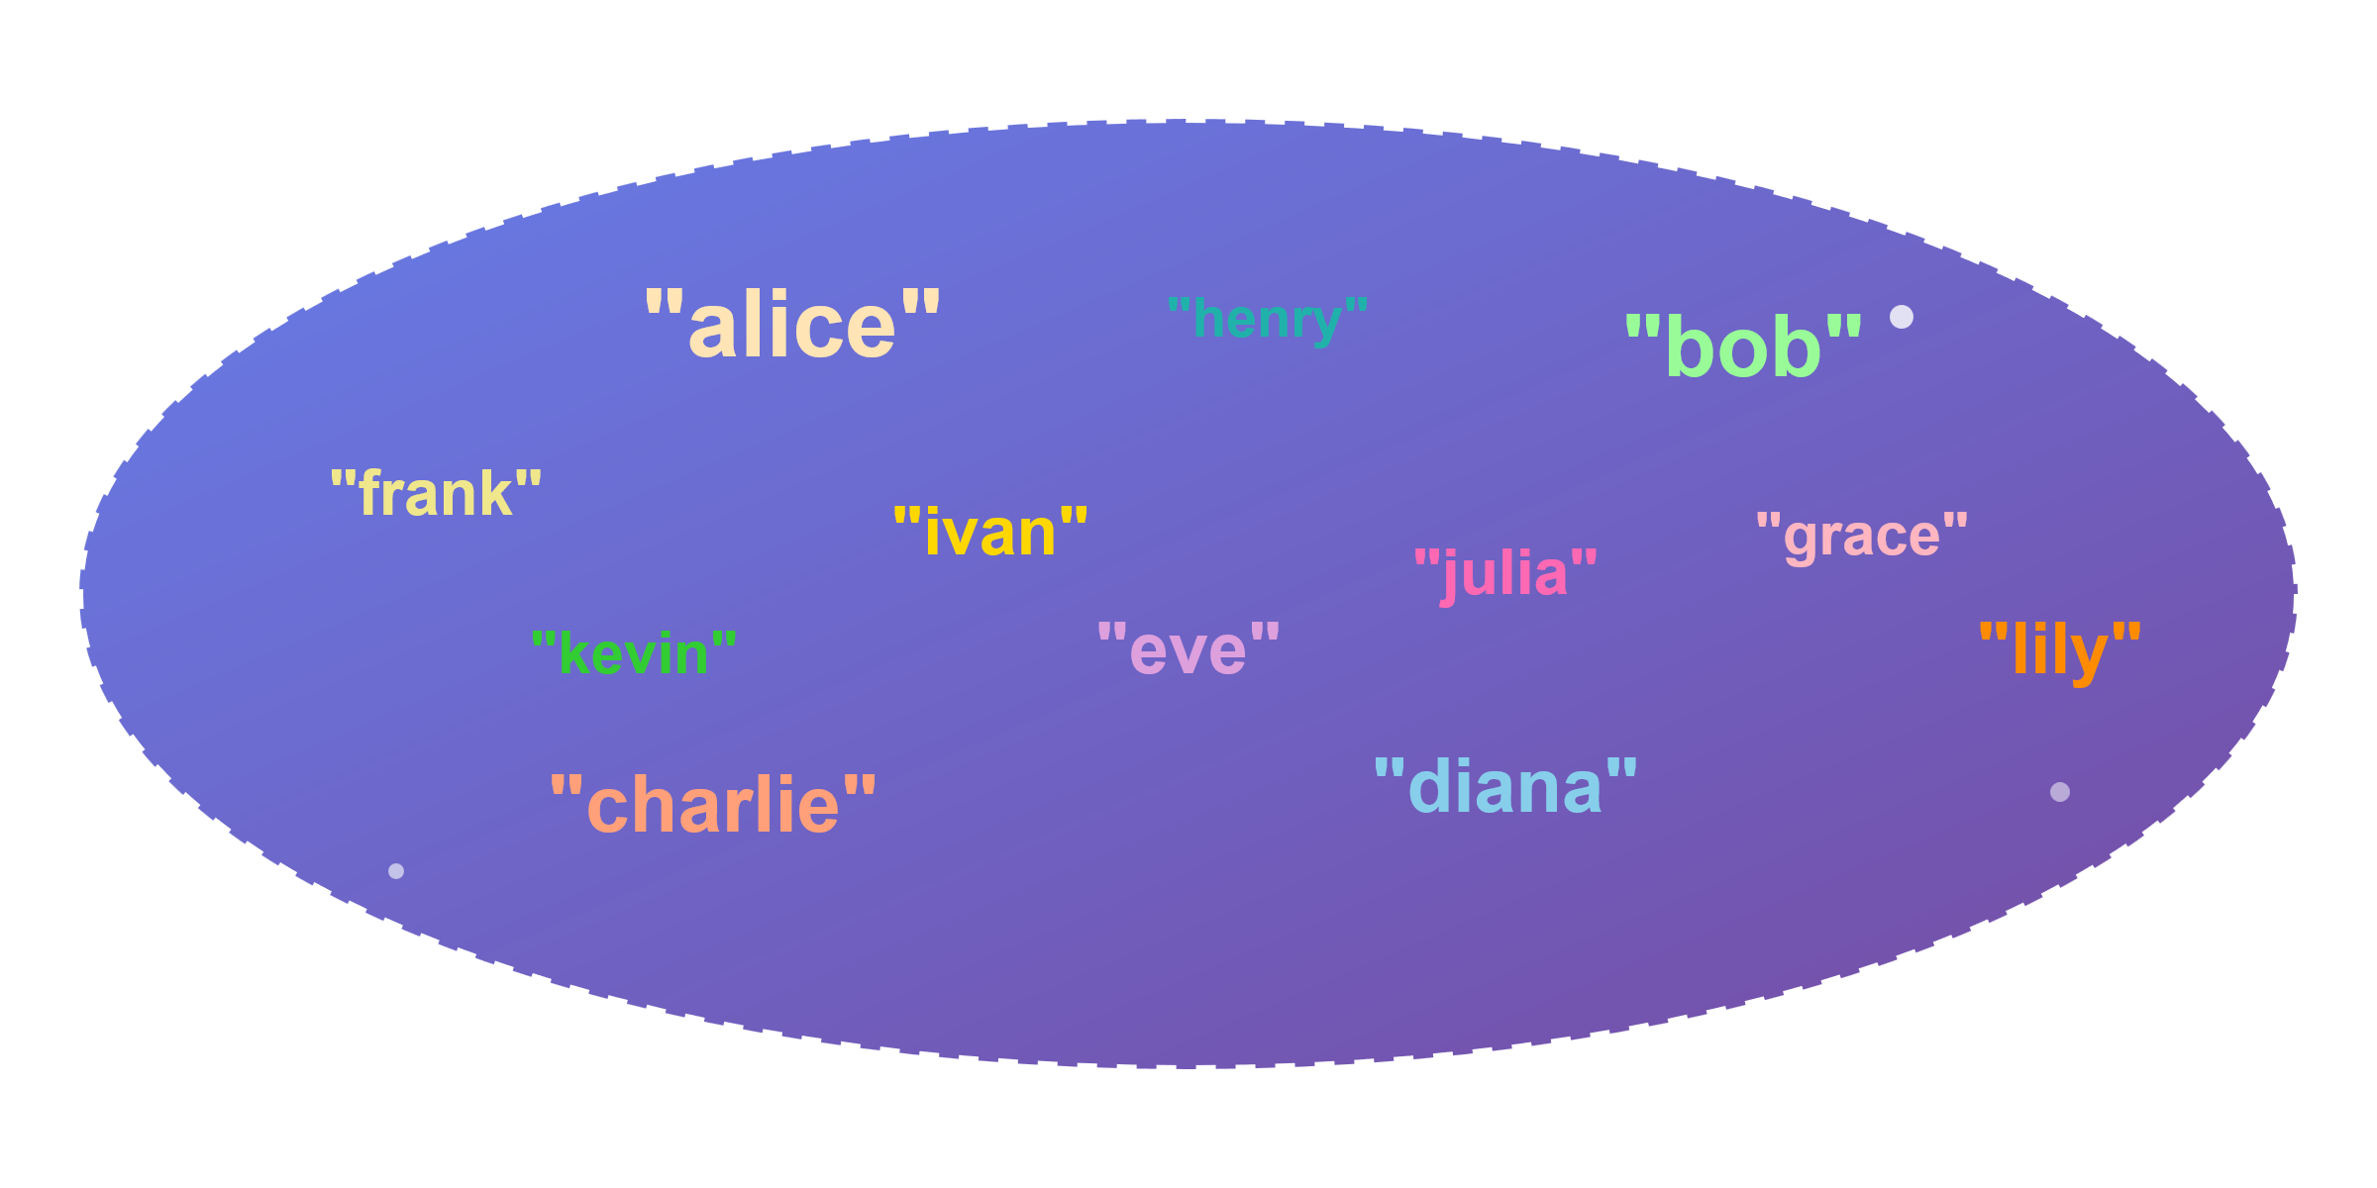
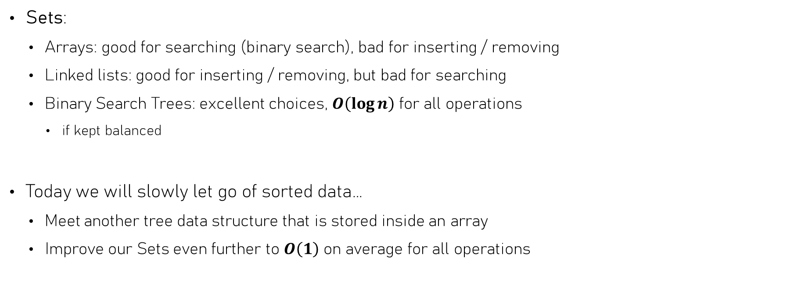
Last weeks we discussed…
Sets:
  Arrays: good for searching (binary search), bad for inserting / removing
  Linked lists: good for inserting / removing, but bad for searching
  Binary Search Trees: excellent choices, $O\left(\log{n}\right)$ for all operations
    if kept balanced
Today we will slowly let go of sorted data…
  Meet another tree data structure that is stored inside an array
  Improve our Sets even further to $O\left(1\right)$ on average for all operations

Slide 3
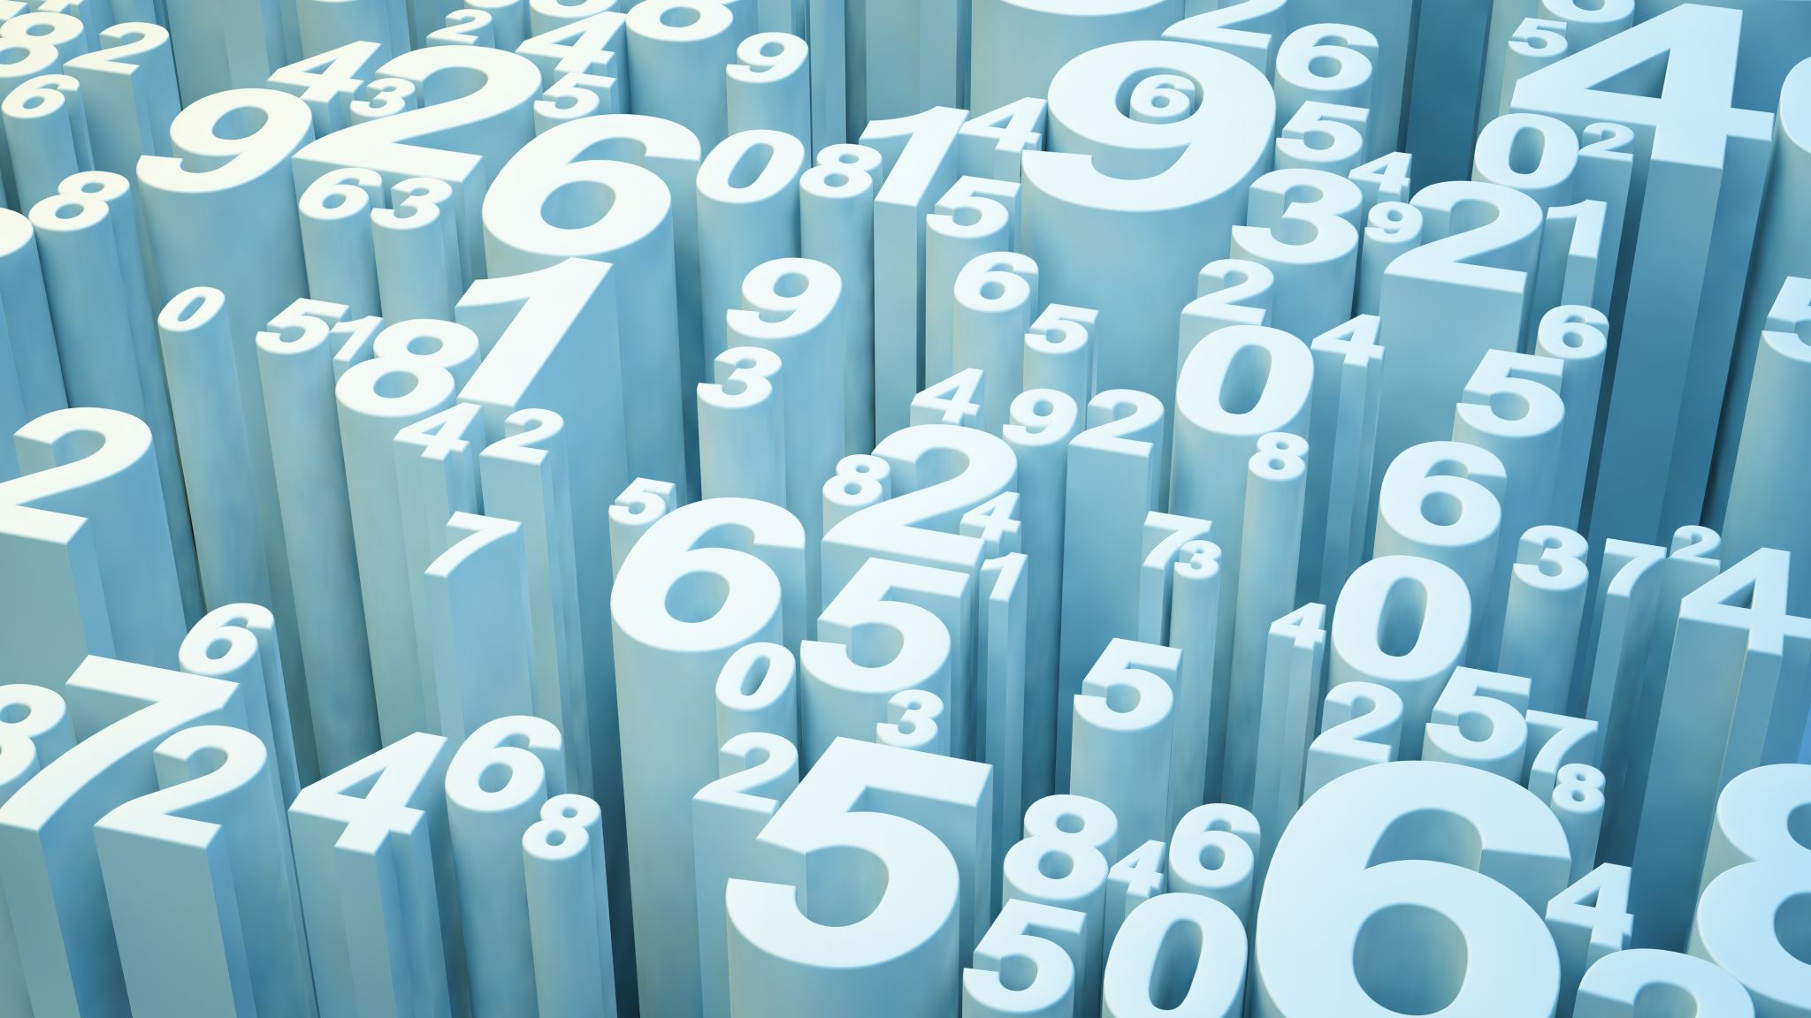
Binary Heaps
Still sort of sorted, but in a different way

Slide 4
Sometimes sorting is not needed
Suppose you must respond to incoming messages
  Handle those with highest priority first
  Insert new ones based on priority
Just need quick access to “minimum” / “maximum” element
  Keeping lower priority messages sorted is not needed
Can we do better than a (balanced) Binary Search Tree?

Slide 5
The binary heap
An array is a contiguous block of values
But nothing stops us from interpreting it in a hierarchical way!
Children
1
1
2
2
3
3
5
5
8
8
13
13
21
21
34
34
55
55
89
89
0
0
1
1
2
2
3
3
4
4
5
5
6
6
7
7
8
8
9
9
10
10
11
11
12
12
13
13
14
14
Root value
Store the children of index $k$ at indices $2k + 1$ and $2k + 2$

Slide 6

The binary heap
An array is a contiguous block of values
But nothing stops us from interpreting it in a hierarchical way!
Children
1
1
2
2
3
3
5
5
8
8
13
13
21
21
34
34
55
55
89
89
0
0
1
1
2
2
3
3
4
4
5
5
6
6
7
7
8
8
9
9
10
10
11
11
12
12
13
13
14
14
Root value
Store the children of index $k$ at indices $2k + 1$ and $2k + 2$

Slide 7
The binary heap
An array is a contiguous block of values
But nothing stops us from interpreting it in a hierarchical way!
0
1
1
2
1
2
3
5
8
13
21
34
55
89
2
3
0
1
2
3
4
5
6
7
8
9
10
11
12
13
14
3
4
5
6
5
8
13
21
7
8
9
10
11
12
13
14
Store the children of index $k$ at indices $2k + 1$ and $2k + 2$
34
55
89

Slide 8
The binary heap
Like a binary tree, but stored inside an array
  No gaps ➔ all levels filled before next one is
Can’t keep things sorted like a BST!
0
1
1
2
1
2
3
5
8
13
21
34
55
89
2
3
0
1
2
3
4
5
6
7
8
9
10
11
12
13
14
3
4
5
6
5
8
13
21
7
8
9
10
11
12
13
14
Store the children of index $k$ at indices $2k + 1$ and $2k + 2$
34
55
89

Slide 9
The binary heap
This is called the heap property
What we can keep sorted is the path from top to bottom
  Each value is smaller than (or equal to) both of its child values
When removing / inserting values, we must ensure they are kept sorted
0
1
1
2
1
2
3
5
8
13
21
34
55
89
2
3
0
1
2
3
4
5
6
7
8
9
10
11
12
13
14
3
4
5
6
5
8
13
21
7
8
9
10
11
12
13
14
34
55
89

Slide 10
The Heap property
This is called a Max-heap
For which of these arrays does the heap property hold?
This is called a Min-heap
0
0
0
1
10
42
1
2
1
2
1
2
7
4
12
17
21
35
3
4
5
6
3
4
5
6
3
4
5
6
42
8
9
21
13
25
15
21
9
2
10
18
7
8
9
10
11
12
13
7
8
9
10
7
8
9
10
11
12
13
14
66
55
12
21
15
99
24
75
14
42
33
4
8
2
1
2
6
1
16

Slide 11
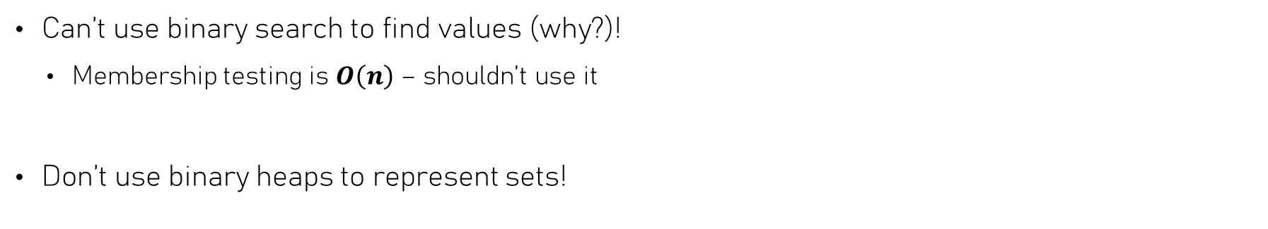
The binary heap – Finding things
Can’t use binary search to find values (why?)!
  Membership testing is $O\left(n\right)$ – shouldn’t use it
Don’t use binary heaps to represent sets!
0
1
1
2
1
2
3
5
8
13
21
34
55
89
2
3
0
1
2
3
4
5
6
7
8
9
10
11
12
13
14
3
4
5
6
5
8
13
21
7
8
9
10
11
12
13
14
34
55
89

Slide 12
The Binary Heap – Priority Queue
Binary Heap is used to quickly find out what the element with highest priority (smallest) is
In addition, we should be able to:
  Remove the value with highest priority
  Insert a new value & restore heap property
0
1
1
2
1
2
3
5
8
13
21
34
55
89
2
3
0
1
2
3
4
5
6
7
8
9
10
11
12
13
14
3
4
5
6
5
8
13
21
7
8
9
10
11
12
13
14
34
55
89

Slide 13


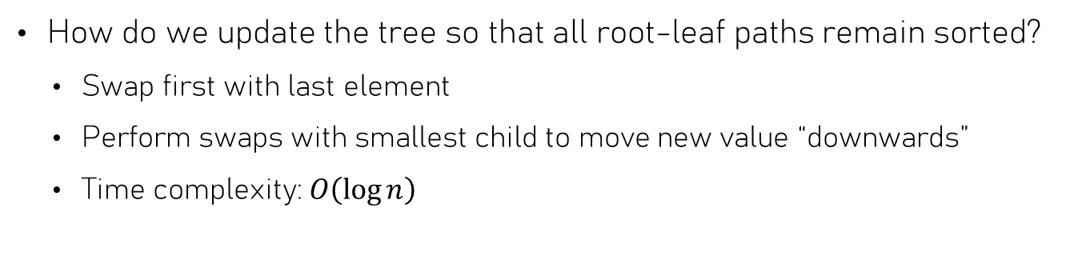
The Binary Heap – Min-Removal
This is called “bubbling down”
How do we update the tree so that all root-leaf paths remain sorted?
  Swap first with last element
  Perform swaps with smallest child to move new value “downwards”
  Time complexity: $O\left(\log{n}\right)$
0
1
1
2
1
2
3
5
8
13
21
34
55
89
2
3
0
1
2
3
4
5
6
7
8
9
10
11
12
13
14
3
4
5
6
5
8
13
21
Invalid
Heap!
Valid
Heap!
7
8
9
10
11
12
13
14
34
55
89

Slide 14
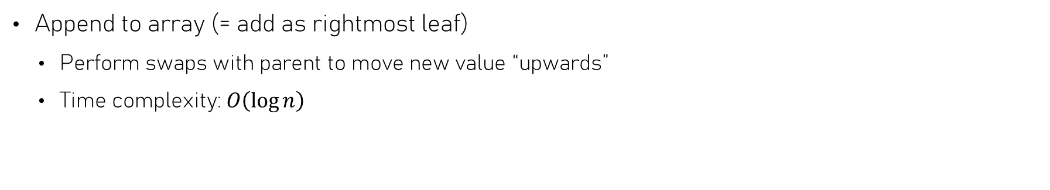
The Binary Heap – Insertion
This is called “bubbling up”
Append to array (= add as rightmost leaf)
  Perform swaps with parent to move new value “upwards”
  Time complexity: $O\left(\log{n}\right)$
0
1
1
2
1
4
3
5
8
13
21
34
55
89
4
3
0
1
2
3
4
5
6
7
8
9
10
11
12
13
14
3
4
5
6
5
8
13
21
Invalid
Heap!
Valid
Heap!
7
8
9
10
11
12
13
14
34
55
89
2
2

Slide 15



Removing is sorting!
Removal puts smallest value at end of array
Repeating until heap is empty: all values are sorted
What is the time complexity of sorting in this way?
Once the data satisfies the heap property, we can easily sort it
  But how much work is it to let arbitrary data satisfy the heap property?
$$O\left(n\log{n}\right)$$

Slide 16
Building a Heap - Heapify
Make heap by bubble-sorting all root-leaf paths
Go over values from last to first
  Swap values downwards while needed (bubble down)
  Restores heap property bottom-up
0
25
1
2
25
15
10
13
9
8
21
11
4
5
1
4
3
6
12
15
10
0
1
2
3
4
5
6
7
8
9
10
11
12
13
14
3
4
5
6
13
9
8
21
Invalid
Heap!
Valid
Heap!
7
8
9
10
11
12
13
14
11
4
5
1
4
3
6
12

Slide 17
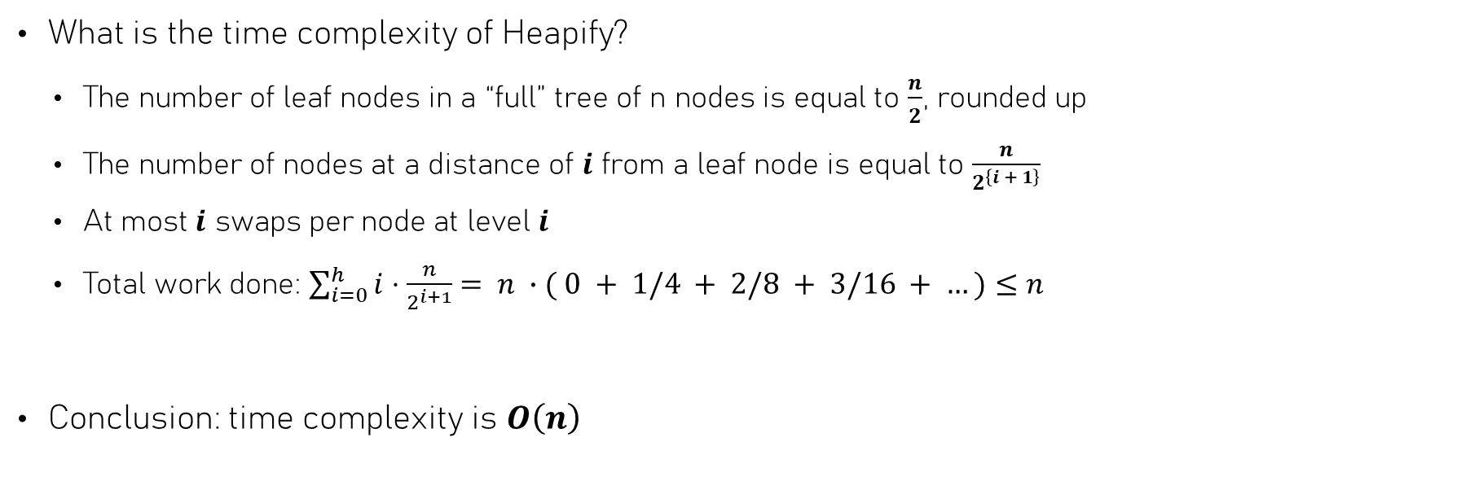
Building a Heap - Heapify
What is the time complexity of Heapify?
  The number of leaf nodes in a “full” tree of n nodes is equal to $\frac{n}{2}$, rounded up
  The number of nodes at a distance of $i$ from a leaf node is equal to $\frac{n}{2^{\left\{i + 1\right\}}}$
  At most $i$ swaps per node at level $i$
  Total work done: $\sum_{i=0}^{h}{i}⋅\frac{n}{2^{i+1}}$ $= n ∙( 0 + 1/4 + 2/8 + 3/16 + …)≤n$
Conclusion: time complexity is $O\left(n\right)$

Slide 18

Heap Sort
To sort an array in ascending order:
  Heapify: rearrange the elements to form a max-heap – $O\left(n\right)$
0
25
1
2
25
15
10
42
9
8
21
11
4
5
1
15
10
0
1
2
3
4
5
6
7
8
9
10
3
4
5
6
42
9
8
21
Invalid
Heap!
Valid
Heap!
7
8
9
10
11
4
5
1

Slide 19

Heap Sort
To sort an array in ascending order:
  Heapify: rearrange the elements to form a max-heap – $O\left(n\right)$
  Keep removing each element until the heap is empty – $O\left(\log{n}\right)$ per element
42
42
25
21
15
9
8
10
11
4
5
1
25
21
0
1
2
3
4
5
6
7
8
9
10
15
9
8
10
Invalid
Heap!
Valid
Heap!
11
4
5
1

Slide 20
Heap Sort
To sort an array in ascending order:
  Heapify: rearrange the elements to form a max-heap – $O\left(n\right)$
  Keep removing each element until the heap is empty – $O\left(\log{n}\right)$ per element
25
25
15
21
11
9
8
10
1
4
5
42
15
21
0
1
2
3
4
5
6
7
8
9
10
11
9
8
10
Invalid
Heap!
Valid
Heap!
1
4
5

Slide 21
Heap Sort
To sort an array in ascending order:
  Heapify: rearrange the elements to form a max-heap – $O\left(n\right)$
  Keep removing each element until the heap is empty – $O\left(\log{n}\right)$ per element
21
21
15
10
11
9
8
5
1
4
25
42
15
10
0
1
2
3
4
5
6
7
8
9
10
11
9
8
5
Invalid
Heap!
Valid
Heap!
1
4

Slide 22
Heap Sort
To sort an array in ascending order:
  Heapify: rearrange the elements to form a max-heap – $O\left(n\right)$
  Keep removing each element until the heap is empty – $O\left(\log{n}\right)$ per element
15
15
11
10
4
9
8
5
1
21
25
42
11
10
0
1
2
3
4
5
6
7
8
9
10
4
9
8
5
Invalid
Heap!
Valid
Heap!
1

Slide 23
Heap Sort
To sort an array in ascending order:
  Heapify: rearrange the elements to form a max-heap – $O\left(n\right)$
  Keep removing each element until the heap is empty – $O\left(\log{n}\right)$ per element
11
11
9
10
4
1
8
5
15
21
25
42
9
10
0
1
2
3
4
5
6
7
8
9
10
4
1
8
5
Invalid
Heap!
Valid
Heap!

Slide 24
Heap Sort
To sort an array in ascending order:
  Heapify: rearrange the elements to form a max-heap – $O\left(n\right)$
  Keep removing each element until the heap is empty – $O\left(\log{n}\right)$ per element
10
10
9
8
4
1
5
11
15
21
25
42
9
8
0
1
2
3
4
5
6
7
8
9
10
4
1
5
Invalid
Heap!
Valid
Heap!

Slide 25
Heap Sort
To sort an array in ascending order:
  Heapify: rearrange the elements to form a max-heap – $O\left(n\right)$
  Keep removing each element until the heap is empty – $O\left(\log{n}\right)$ per element
9
9
5
8
4
1
10
11
15
21
25
42
5
8
0
1
2
3
4
5
6
7
8
9
10
4
1
Invalid
Heap!
Valid
Heap!

Slide 26
Heap Sort
To sort an array in ascending order:
  Heapify: rearrange the elements to form a max-heap – $O\left(n\right)$
  Keep removing each element until the heap is empty – $O\left(\log{n}\right)$ per element
8
8
5
1
4
9
10
11
15
21
25
42
5
1
0
1
2
3
4
5
6
7
8
9
10
4
Invalid
Heap!
Valid
Heap!

Slide 27
Heap Sort
To sort an array in ascending order:
  Heapify: rearrange the elements to form a max-heap – $O\left(n\right)$
  Keep removing each element until the heap is empty – $O\left(\log{n}\right)$ per element
5
5
4
1
8
9
10
11
15
21
25
42
4
1
0
1
2
3
4
5
6
7
8
9
10
Invalid
Heap!
Valid
Heap!

Slide 28
Heap Sort
To sort an array in ascending order:
  Heapify: rearrange the elements to form a max-heap – $O\left(n\right)$
  Keep removing each element until the heap is empty – $O\left(\log{n}\right)$ per element
4
4
1
5
8
9
10
11
15
21
25
42
1
0
1
2
3
4
5
6
7
8
9
10
Valid
Heap!

Slide 29
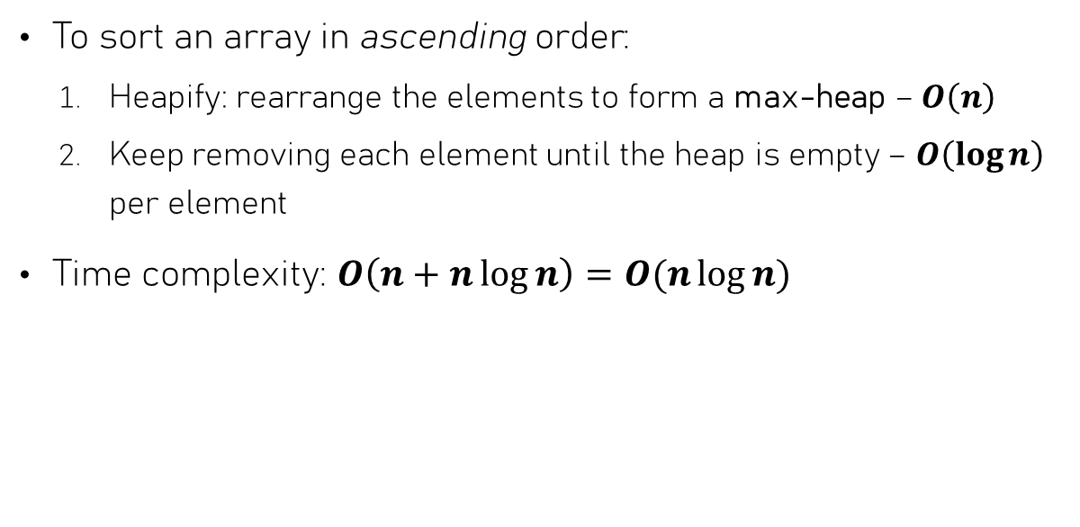
Heap Sort
To sort an array in ascending order:
  Heapify: rearrange the elements to form a max-heap – $O\left(n\right)$
  Keep removing each element until the heap is empty – $O\left(\log{n}\right)$ per element
Time complexity: $O\left(n+n\log{n}\right)=O(n\log{n})$
1
1
4
5
8
9
10
11
15
21
25
42
0
1
2
3
4
5
6
7
8
9
10
Valid
Heap!

Slide 30
Binary Heaps in C++
Build a heap from (part of) e.g. a vector: std::make_heap(begin, end) (cppreference)
Insert a value into a heap: std::push_heap(begin, end) (cppreference)
  Inserts value at end – 1 into the heap
Remove the top value: std::pop_heap(begin, end) (cppreference)
  Removed value will be at end - 1
To compare values, these functions either:
  use the bool operator< member function of the class
  Use the function that is passed as an (optional) argument

Slide 31
Hash Tables
Who needs sorting, anyway?

Slide 32

To sort or not to sort
Why were we so focused on keeping data sorted in the first place?
Because it’s easier to find things if they’re sorted, right?
How do we do this in real life?

Slide 33
To sort or not to sort
How are books in a library sorted?
Typically: catalog numbers
  Gives section to look for a book
  Inside section, books are sorted
  Two-step process to find the book
Use a simple piece of information to quickly narrow down location

Slide 34

Arrays as sets – using value as location
Imagine a set of int that is implemented as an array
Instead of keeping values inside a contiguous block, use the value as its index!
  Insert: array[x] = x
  Membership test: array[x] == x
insert 2
1
2
7
insert 7
0
1
2
3
4
5
6
7
8
9
10
insert 1
insert 15

Slide 35
Arrays as sets – using value as location
Imagine a set of int that is implemented as an array
Instead of keeping values inside a contiguous block, use the value as its index!
  Insert: array[x] = x
  Membership test: array[x] == x
insert 2
1
2
7
insert 7
0
1
2
3
4
5
6
7
8
9
10
insert 1
insert 15

Slide 36
Modulo indexing
Apply modulo to stay within bounds
  Insert: array[x % size] = x
  Membership test: array[x % size] == x
insert 15
Stored @4
1
2
15
7
75
insert 75
Stored @9
0
1
2
3
4
5
6
7
8
9
10
find 20
@9: not there
15 % 11
75 % 11
insert 48
Already occupied!
48 % 11
20 % 11

Slide 37
Resolving collisions – linear probing
In case a slot is already occupied, try the next ones until a free spot is found – probing
  There are more advanced probing schemes
Problem: what if we remove values?
insert 15
1
2
15
48
7
75
insert 75
0
1
2
3
4
5
6
7
8
9
10
find 20
insert 48
Stored @5
48 % 11

Slide 38
Resolving collisions – separate chaining
Keep a (singly) linked list in each “slot”
1
2
15
7
75
0
1
2
3
4
5
6
7
8
9
10

Slide 39
Resolving collisions – separate chaining
Keep a (singly) linked list in each “slot”
1
2
15
7
75
0
1
2
3
4
5
6
7
8
9
10

Slide 40
Resolving collisions – separate chaining
Keep a (singly) linked list in each “slot”
  Insert: array[x % size].prepend(x)
  Membership test: array[x % size].find(x)
  Remove: array[x % size].remove(x)
0
1
2
3
4
5
6
7
8
9
10
insert 23
23
insert 86
86
1
2
15
7
75
find 45
insert 48
48

Slide 41
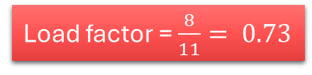
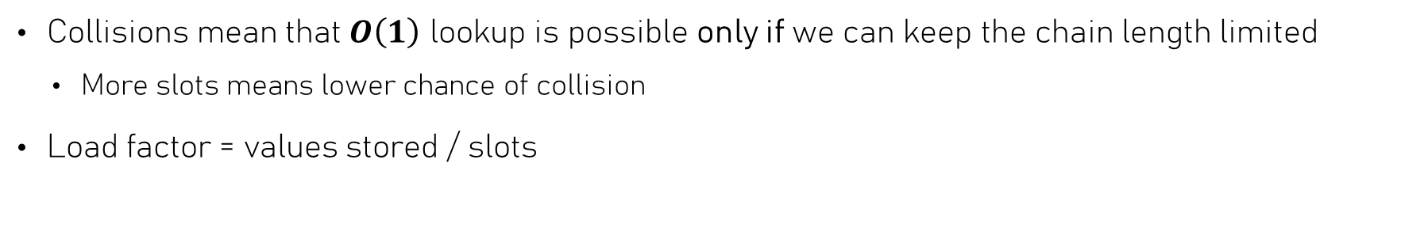
Collisions & performance
Collisions mean that $O\left(1\right)$ lookup is possible only if we can keep the chain length limited
  More slots means lower chance of collision
Load factor = values stored / slots
0
1
2
3
4
5
6
7
8
9
10
23
2
48
7
86
Load factor = $\frac{8}{11}= 0.73$
1
15
75

Slide 42
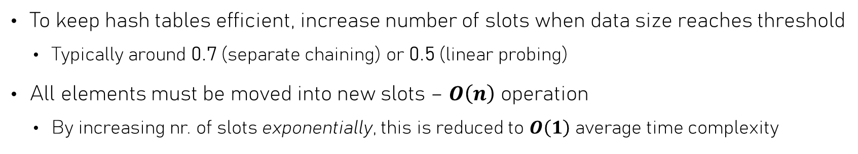
Load factor & Rehashing
To keep hash tables efficient, increase number of slots when data size reaches threshold
  Typically around 0.7 (separate chaining) or 0.5 (linear probing)
All elements must be moved into new slots – $O\left(n\right)$ operation
  By increasing nr. of slots exponentially, this is reduced to $O\left(1\right)$ average time complexity
Load factor = 0.73
0
1
2
3
4
5
6
7
8
9
10
0
1
2
3
4
5
6
7
8
9
10
11
12
13
23
2
48
7
86
1
15
75
Load factor = 0.57

Slide 43
Hash functions
Storing only ints is very restrictive – what about other data types?
  Every object is stored in memory as a sequence of bytes
  Bytes are numbers, so everything is a number & can be turned into an array index!
Hash
Function
(MurmurHash)
Value: Hello, world!
Type: std::string
12518601801603912089
(0xadbb02031d2a9199)
Hash functions turn data into a number
We can do this for any type!

Slide 44
Associative arrays & dictionaries
Hash functions allow us to use “indexing” in a more generic way
passwords["alice"] = "bluB!123"
passwords["dave"] = "p^zz@"
Hash: 0x7f7af45cf1a7bf22
Index: 2
Hash: 0xf80da7b1d331ca49
Index: 8
0
1
2
3
4
5
6
7
8
9
10
passwords:
Note that the key is stored as well!
Key: "alice"
Value: "blub!123"
Key: "dave"
Value: "p^zza@"
Note: never store passwords like this! ☺

Slide 45

Hash & equality
Steps to locate a value:
  Use the hash function to find slot
  Use the equality operator (==) to see if it’s there
Requires a “contract” between hash code & equality of two objects obj1 and obj2:
  IF hash(obj1) != hash(obj2), THEN obj != obj2
  IF obj1 == obj2, THEN hash(obj1) == hash(obj2)

Slide 46
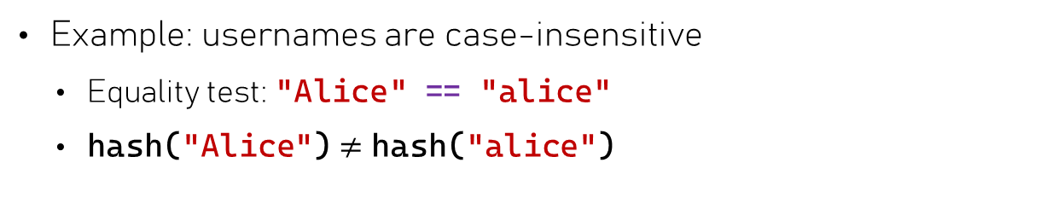
Hash & equality – what could go wrong
Lookup password for "Alice"
Example: usernames are case-insensitive
  Equality test: "Alice" == "alice"
  hash("Alice") $≠$ hash("alice")
Hash: 0x69b67baeb34b7ca9
Index: 10
User "Alice"
not found!
0
1
2
3
4
5
6
7
8
9
10
Key: "alice"
Value: "blub!123"
Key: "dave"
Value: "p^zza@"

Slide 47


Hash Tables – Time complexities
A good hash function minimizes the chances of collision
If we maintain a low enough load factor, then for a Hash set / Hash map:
  Insert, Remove, Membership test: all $O\left(1\right)$ on average
What we should not do:
  Find smallest / greatest: $O\left(n\right)$
  Iterate elements in order: how would you do this?

Slide 48
Hash tables in C++
The C++ Standard Template Library (STL) contains two types of hash tables
  std::unordered_set: implements a set
  std::unordered_map: implements a dictionary / map
We can only store values there that can be hashed
  Using std::unordered_set<ourclass>: we must:
    Ensure that a hash can be computed for ourclass
    Ensure that we can compare two ourclass instances for equality

Slide 49
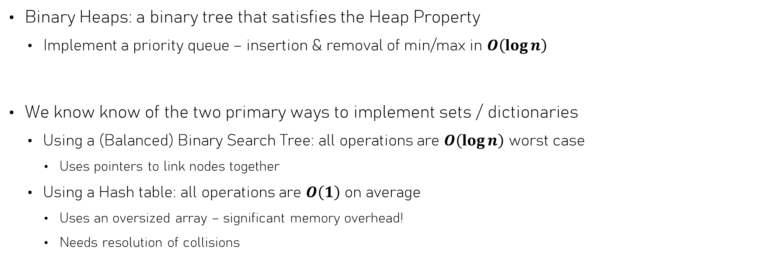
Summary
Binary Heaps: a binary tree that satisfies the Heap Property
  Implement a priority queue – insertion & removal of min/max in $O\left(\log{n}\right)$
We know know of the two primary ways to implement sets / dictionaries
  Using a (Balanced) Binary Search Tree: all operations are $O\left(\log{n}\right)$ worst case
    Uses pointers to link nodes together
  Using a Hash table: all operations are $O\left(1\right)$ on average
    Uses an oversized array – significant memory overhead!
    Needs resolution of collisions

Slide 50


